Slide 1
UNIT 4
Testing methods

Slide 2
Verification testing
Basic verification methods,
Getting leverage on verification,
Verifying documents at different phases, getting the best from verification,
Three critical success factors for implementing verification,
Recommendation.

Slide 3
Verification testing
Main objective of each verification activity is
to detect as many errors as possible.
Testing team need to participate in inspections and walkthroughs
Develop their own Testware- generic and test specific checklists and also verify Testware.
Basic Verification Methods
“Human” examination or review of work product.
Reviews such as inspections, walkthroughs, technical reviews and other methods

Slide 4
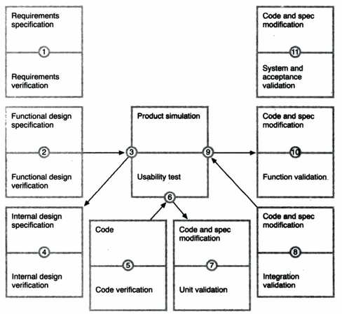

Slide 5
Formal structured types of verification
Inspections: central event
Meeting at which defects are detected in the product under review.
Key elements
Every one in the review group participates openly and actively.
Written report is produced regarding the status of product.
Review group is responsible for the quality of information in report.

Slide 6
Inspections : key elements and phases
objectives:
Obtain defects and collect data
Meeting does not examine alternate solution
To communicate important work product information.
Elements:
Planned structured meeting required individual preparation by all participants
Team of 3-6 people, led by impartial moderator
Presenter is reader other than producer

Slide 7
Input:
Document to be inspected
Related source documents
General and tailored checklists
Output:
Inspection summary/report
Data on error types
key phrases:
Briefing/entry/-individual preparation inspection meeting-edit/rework/ exit/re-inspect collect data.
Casual analysis meeting.

Slide 8
Walkthroughs
Less formal than inspections
Lack of preparation
Participants simply come to the meeting
Presenter prepares
No additional effort by participants prior to the meeting.

Slide 9
Walkthroughs Key elements:
Objectives: to detect defects and to become familiar with the material.
Elements:
A planned meeting where only the presenter must prepare.
A team of 2-7 people led by the producer/author.
The presenter is usually the producer.

Slide 10
input:
Elements under examination
Objectives for the walkthrough, applicable standards.
Output:
Report

Slide 11
Cover more material than inspections.
Purpose for communication.
Don’t know whats there exactly
If defects found that’s fine.
Main goal is to familiarize with product.
Dis: review tends to be less objective when presenter is producer.

Slide 12
Buddy checks
Any form of human testing, even undisciplined testing.
Performed other than author,
Detect defects

Slide 13
Getting leverage on verification (what and how much verification to do)
How many defects are we finding
How many are found during review and later validation.
What percentage are left at the end and only being found by customers.

Slide 14
Verifying documents at different phases
Verifying requirements
Understand users need
Capability needed by users
What they want.

Slide 15
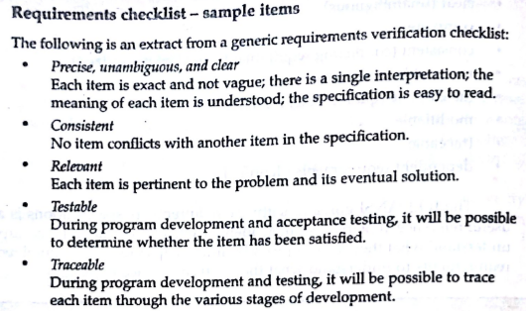

Slide 16
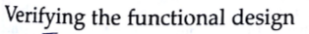
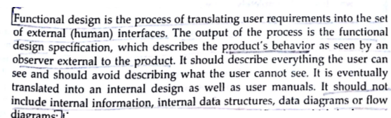

Slide 17
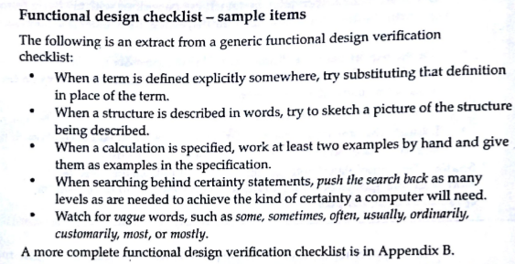

Slide 18
Goal is :
How successful user requirements have been incorporated into functional design.
failings of FDS is Incompleteness.
What’s missing.

Slide 19
Internal design
Translating functional specification into internal design.
Data flows, algorithms.
How the product is built.
Reviewing internal design involved using checklist tracing the path back

Slide 20
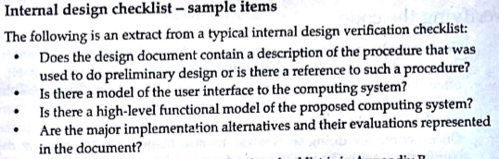

Slide 21
Verifying code
Coding is a process of translating detailed design specification into specific code.
Do walkthroughs and inspections on code.

Slide 22
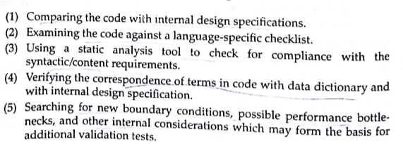

Slide 23
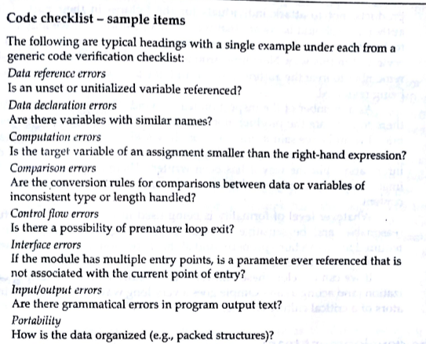

Slide 24
Getting best from verification (explain each one)
Author
Development team
Inspection team
Cost effective verification

Slide 25
Three critical success factors for implementing verification
Success factor 1 : Process ownership
Success factor 2:Management support
Success factor 3:Training

Slide 26
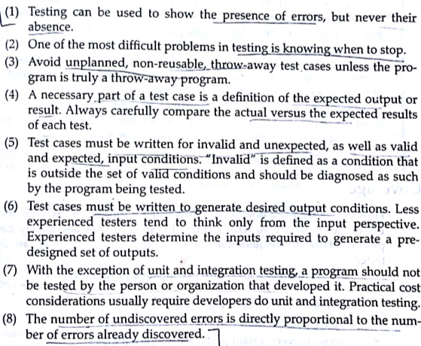
Validation testing
8 axioms that apply to all validation testing

Slide 27
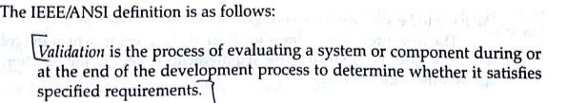
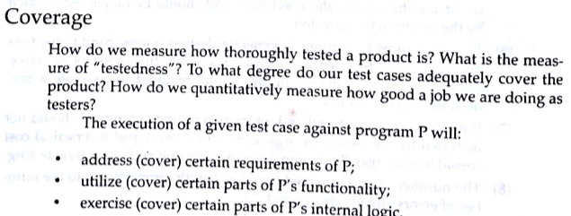

Slide 28
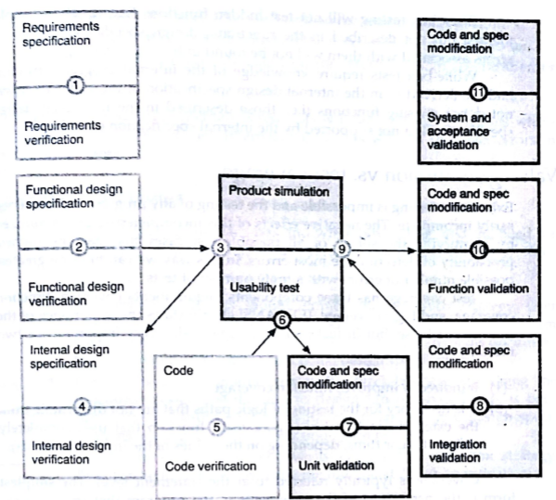

Slide 29
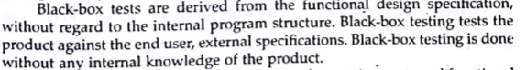
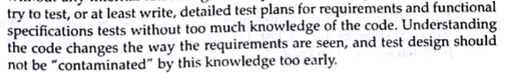
Fundamental testing strategies

Slide 30
Validation mission vs test coverage
3 components:
REQ coverage
Function coverage
Logic coverage
Coverage refers to statement level
% of statements in the program being executed.

Slide 31
Test basis
Requirement based
Functional based
Internal based

Slide 32
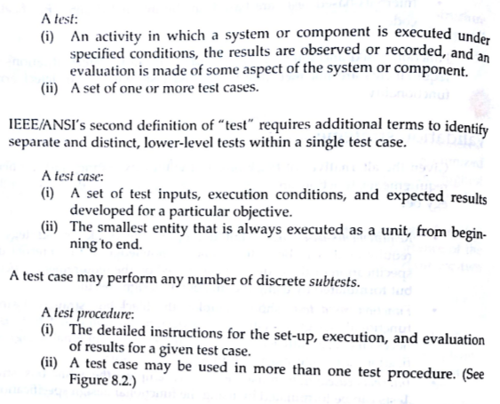

Slide 33
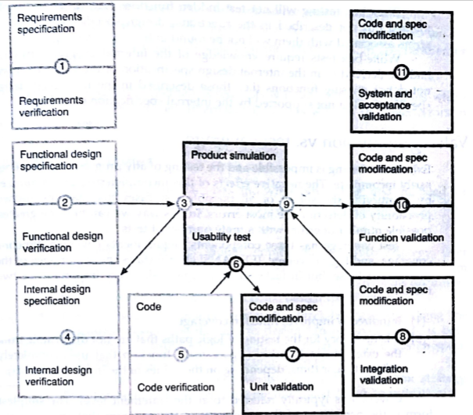

Slide 34
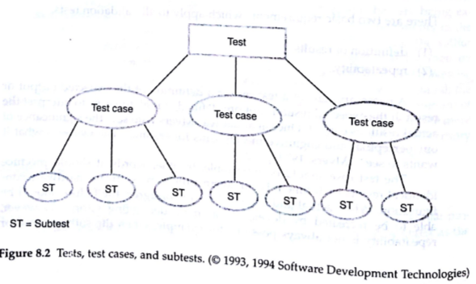

Slide 35
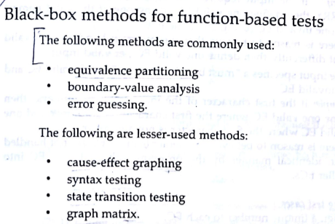

Slide 36
Boundary Value Analysis
A greater number of errors occur at the boundaries of the input domain rather than in the "center"
Boundary value analysis is a test case design method that complements equivalence partitioning
It selects test cases at the edges of a class
It derives test cases from both the input domain and output domain

Slide 37
Equivalence partitioning
Equivalence partitioning is a software testing technique that divides the input and/or output data of a software unit into partitions of data from which test cases can be derived.
The equivalence partitions are usually derived from the requirements specification for input attributes that influence the processing of the test object.
Test cases are designed to cover each partition at least once.

Slide 38
What can be found using equivalence partitioning?
Equivalence partitioning technique uncovers classes of errors.
Testing uncovers sets of inputs that causes errors or failures, not just individual inputs.

Slide 39
What can be partitioned?
Usually it is the input data that is partitioned.
However, depending on the software unit to be tested, output data can be partitioned as well.
Each partition shall contain a set or range of values, chosen such that all the values can reasonably be expected to be treated by the component in the same way (i.e. they may be considered ‘equivalent’).

Slide 40
Recommendations on defining partitions
A number of items must be considered:
All valid input data for a given condition are likely to go through the same process.
Invalid data can go through various processes and need to be evaluated more carefully. For example:
a blank entry may be treated differently than an incorrect entry,
a value that is less than a range of values may be treated differently than a value that is greater,
if there is more than one error condition within a particular function, one error may override the other, which means the subordinate error does not get tested unless the other value is valid.

Slide 41
Equivalence partitioning
Equivalence partitioning is a software testing technique that divides the input and/or output data of a software unit into partitions of data from which test cases can be derived.
The equivalence partitions are usually derived from the requirements specification for input attributes that influence the processing of the test object.
Test cases are designed to cover each partition at least once.

Slide 42
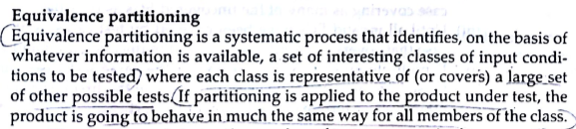

Slide 43
What can be found using equivalence partitioning?
Equivalence partitioning technique uncovers classes of errors.
Testing uncovers sets of inputs that causes errors or failures, not just individual inputs.

Slide 44
What can be partitioned?
Usually it is the input data that is partitioned.
However, depending on the software unit to be tested, output data can be partitioned as well.
Each partition shall contain a set or range of values, chosen such that all the values can reasonably be expected to be treated by the component in the same way (i.e. they may be considered ‘equivalent’).

Slide 45
Equivalence partitioning example
Example of a function which takes a parameter “month”.
The valid range for the month is 1 to 12, representing January to December. This valid range is called a partition.
In this example there are two further partitions of invalid ranges.
x < 1
1 ≤ x ≤ 12
12 < x

Slide 46
Equivalence partitioning example
Test cases are chosen so that each partition would be tested.
-2
5
17
x < 1
1 ≤ x ≤ 12
12 < x

Slide 47
So, is it black box?
The tendency is to relate equivalence partitioning to so called black box testing.
However grey box technique might be applied as well.

Slide 48
Equivalence partitioning using grey-box technique
Depending upon the input the software internally will run through different paths to perform slightly different actions according to the part of the year.
Therefore middle partition is divided into two subpartitions.
-2
5
8
17
x < 1
1 ≤ x ≤ 6
7 ≤ x ≤ 12
12 < x

Slide 49
Boundary value analysis
Equivalence partitioning is not a stand alone method to determine test cases. It is usually supplemented by boundary value analysis.
Boundary value analysis focuses on values on the edge of an equivalence partition or at the smallest value on either side of an edge.

Slide 50
Equivalence partitioning with boundary value analysis
We use the same example as before.
Test cases are supplemented with boundary values.
-2
1
5
12
17
0
2
11
13
x < 1
1 ≤ x ≤ 12
12 < x

Slide 51
Summary
Pros:
optimum test case size, therefore time-saving;
uncovers a class of error, not just an error with specific data input.
Cons:
possible mistakes when defining partitions;
does not test all inputs.

Slide 52
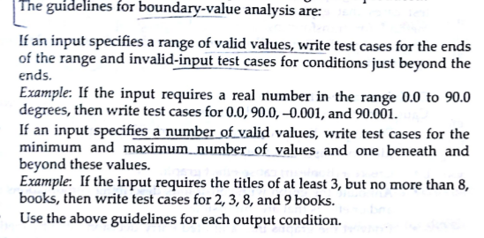

Slide 53
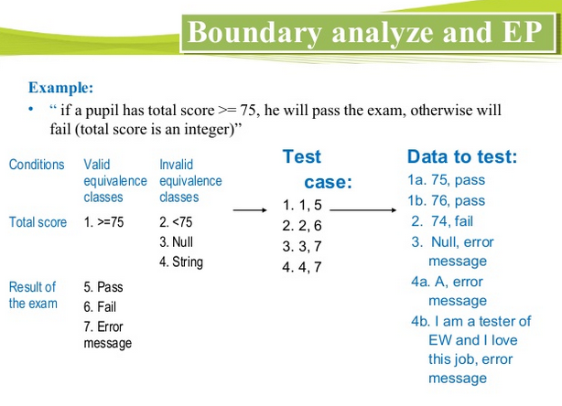

Slide 54
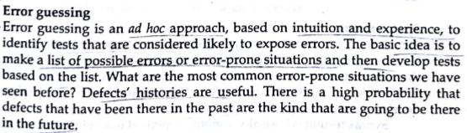

Slide 55
Cause Effect Graph is a black box testing technique that graphically illustrates the relationship between a given outcome and all the factors that influence the outcome.

Slide 56
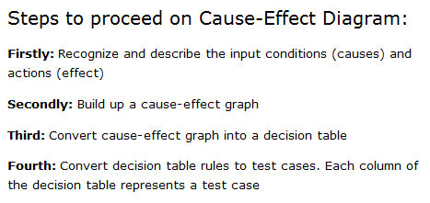

Slide 57
Syntax Testing, a black box testing technique, involves testing the System inputs and it is usually automated because syntax testing produces a large number of tests.
Syntax Testing steps:
Identify the target language or format
Define the syntax of the language
Validate and debug the syntax

Slide 58
State transition testing is used where some aspect of the system can be described in what is called a ‘finite state machine’. This simply means that the system can be in a (finite) number of different states, and the transitions from one state to another are determined by the rules of the ‘machine’..

Slide 59
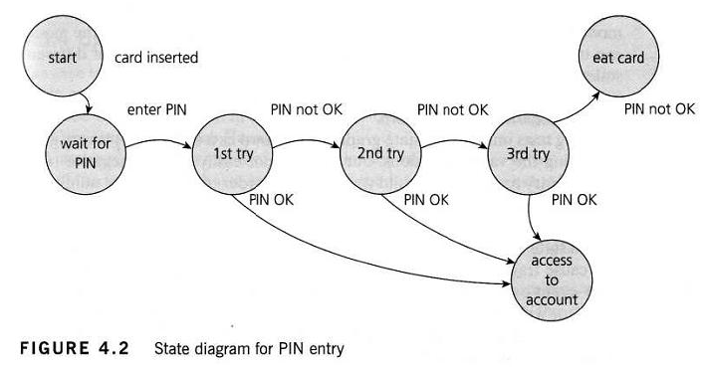

Slide 60
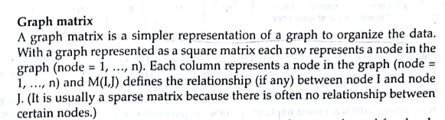

Slide 61
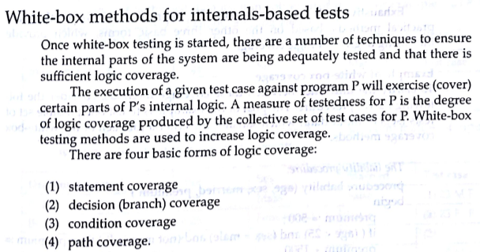

Slide 62
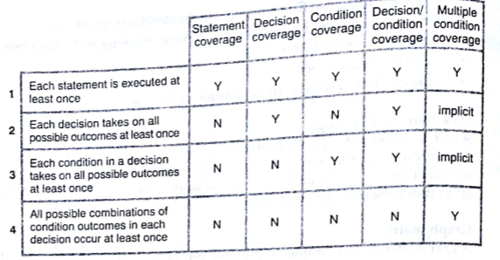

Slide 63
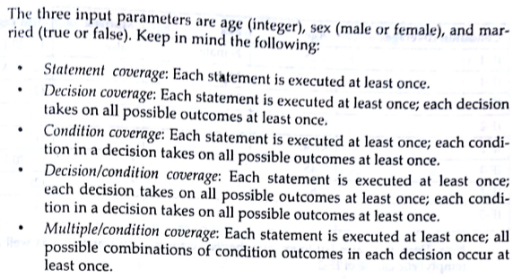

Slide 64
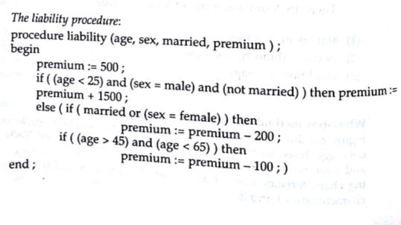

Slide 65
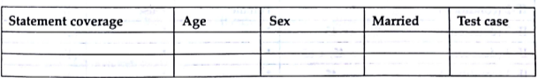
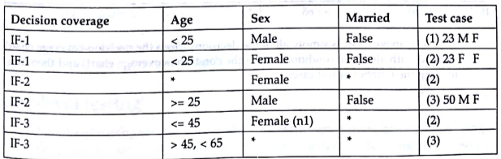

Slide 66
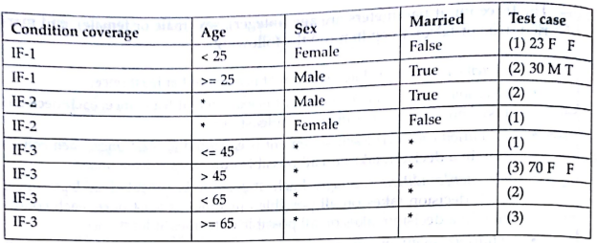

Slide 67
Validation activities
Low level testing
Unit
integration
High level testing
Usability
Function
System
Acceptance

Slide 68
Unit Testing
Algorithms and logic
Data structures (global and local)
Interfaces
Independent paths
Boundary conditions
Error handling

Slide 69
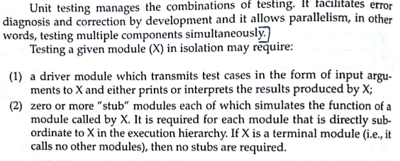

Slide 70
Integration Testing
Defined as a systematic technique for constructing the software architecture
At the same time integration is occurring, conduct tests to uncover errors associated with interfaces
Objective is to take unit tested modules and build a program structure based on the prescribed design
Two Approaches
Non-incremental Integration Testing
Incremental Integration Testing

Slide 71
Non-incremental Integration Testing
Commonly called the “Big Bang” approach
All components are combined in advance
The entire program is tested as a whole
Many seemingly-unrelated errors are encountered
Correction is difficult because isolation of causes is complicated
Once a set of errors are corrected, more errors occur, and testing appears to enter an endless loop

Slide 72
Incremental Integration Testing
Two kinds
Top-down integration
Bottom-up integration
The program is constructed and tested in small increments
Errors are easier to isolate and correct
Interfaces are more likely to be tested completely
A systematic test approach is applied

Slide 73
Top-down Integration
Modules are integrated by moving downward through the control hierarchy, beginning with the main module
Subordinate modules are incorporated in either a depth-first or breadth-first fashion
DF: All modules on a major control path are integrated
BF: All modules directly subordinate at each level are integrated
Advantages
This approach verifies major control or decision points early in the test process
Disadvantages
Stubs need to be created to substitute for modules that have not been built or tested yet; this code is later discarded
Because stubs are used to replace lower level modules, no significant data flow can occur until much later in the integration/testing process

Slide 74
Why Integration Testing Is Necessary
One module can have an adverse effect on another
Subfunctions, when combined, may not produce the desired major function
Individually acceptable imprecision in calculations may be magnified to unacceptable levels

Slide 75
Why Integration Testing Is Necessary (cont’d)
Interfacing errors not detected in unit testing may appear
Timing problems (in real-time systems) are not detectable by unit testing
Resource contention problems are not detectable by unit testing

Slide 76
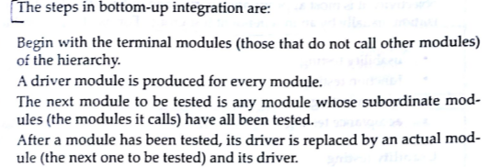
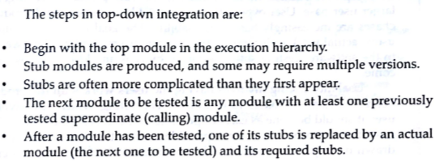

Slide 77
Top-Down Integration
The main control module is used as a driver, and stubs are substituted for all modules directly subordinate to the main module.
Depending on the integration approach selected (depth or breadth first), subordinate stubs are replaced by modules one at a time.

Slide 78
Top-Down Integration (cont’d)
Tests are run as each individual module is integrated.
On the successful completion of a set of tests, another stub is replaced with a real module
Regression testing is performed to ensure that errors have not developed as result of integrating new modules

Slide 79
Problems with Top-Down Integration
Many times, calculations are performed in the modules at the bottom of the hierarchy
Stubs typically do not pass data up to the higher modules
Delaying testing until lower-level modules are ready usually results in integrating many modules at the same time rather than one at a time
Developing stubs that can pass data up is almost as much work as developing the actual module

Slide 80
Bottom-Up Integration
Integration begins with the lowest-level modules, which are combined into clusters, or builds, that perform a specific software subfunction
Drivers (control programs developed as stubs) are written to coordinate test case input and output
The cluster is tested
Drivers are removed and clusters are combined moving upward in the program structure

Slide 81
Problems with Bottom-Up Integration
The whole program does not exist until the last module is integrated
Timing and resource contention problems are not found until late in the process

Slide 82
Unit testing
Concentrates on each component/function of the software as implemented in the source code.
System testing
The software and other system elements are tested as a whole
Alpha testing
Conducted at the developer’s site by end users
Software is used in a natural setting with developers watching intently
Testing is conducted in a controlled environment
Beta testing
Conducted at end-user sites
Developer is generally not present
It serves as a live application of the software in an environment that cannot be controlled by the developer
The end-user records all problems that are encountered and reports these to the developers at regular intervals

Slide 83
Validation Testing
Determine if the software meets all of the requirements defined in the SRS
Having written requirements is essential
Regression testing is performed to determine if the software still meets all of its requirements in light of changes and modifications to the software
Regression testing involves selectively repeating existing validation tests, not developing new tests

Slide 84
Alpha and Beta Testing
It’s best to provide customers with an outline of the things that you would like them to focus on and specific test scenarios for them to execute.
Provide with customers who are actively involved with a commitment to fix defects that they discover.

Slide 85
Acceptance Testing
Similar to validation testing except that customers are present or directly involved.
Usually the tests are developed by the customer

Slide 86
High level testing
Usability
Function testing
System testing
Acceptance testing

Slide 87
